Slide 1
Modeling and Analysis of the Framingham Study Dataset.
Capstone Project by Liat Genosar Roth
About the dataset and the Framingham study:
Cardiovascular diseases (CVDs) are the leading cause of death globally. Framingham Heart Study has been committed to identifying the common factors or characteristics that contribute to CVD, and for the prediction of CVD in Patients. It had followed CVD development over a long period of time in three generations of participants.
The dataset contains the data of 4238 participants. The target to predict is a patient chance to get a cardiovascular disease within 10 years (TenYearCHD). Study population are adults aged 32-70 years, with 57.08% women participating and 42.92% men.
My goal is to find a model that can correctly predict if a patient likely to have CVD within 10 years, and to know the leading factors for it.

Slide 2
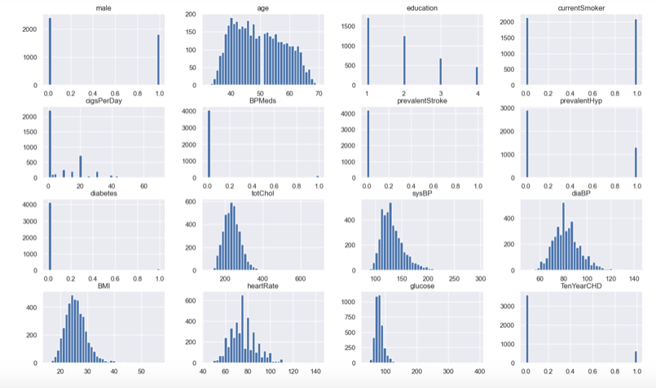
The dataset features describe participants demographics, behavioral, and medical condition.
8 are real numbers, 7 are categorical.

Slide 3
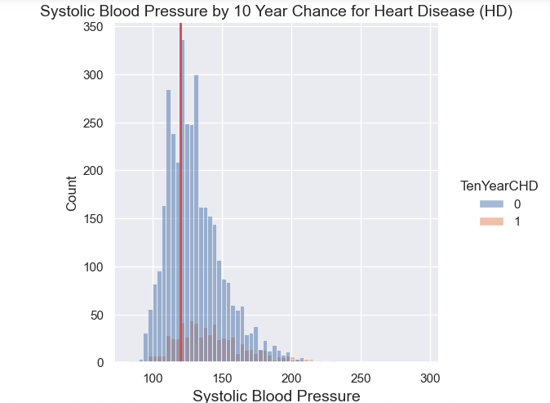
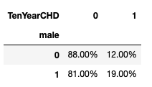
The target column is the 10 year chance for CVD. Participants predicted to have CVD are 15.2% of the total. Accordingly, baseline accuracy for a model is around 84.8%. Current smokers make 49.41%, and 31% of participants have prevalent hypertension.
There’s low correlation of the features with the target. Leading factors are: age (0.225), systolic blood pressure (0.216) and prevalent hypertension (0.178). Men are more likely to get a heart disease:
Systolic blood pressure: As we can see, more than half of the study's population have an elevated level of blood pressure (> 120), which is likely to be a risk factor for CVD. Red line located at sysBP = 120.
Male 0: Women
Male 1: Men

Slide 4
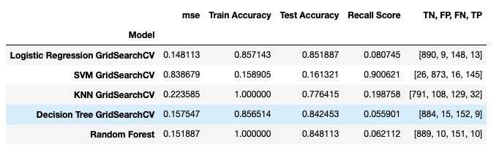
Models and Summary of Results:
I used five classifying models: Logistic Regression, SVM (Support Vector Machine), KNN (k-nearest neighbors), Decision Tree, and Random Forest.
Since this is a crucial health issue, my aim was to find a model that can accurately best predict true positive patients, with the lowest number of false negatives. Thus my evaluation for the model performance was by the recall score.
SVM model came first with a recall score of 90.06%. This came with a low test set accuracy of 16.13%. KNN model came second with a recall score of 19.88%.
Logistic Regression, Random Forest and Decision Tree models helped to identify leading factors for CVD.
I separated the dataset by gender and analyzed each. It resulted with better recall scores for SVM model, for both men and women data.
Models Summary >>>

Slide 5
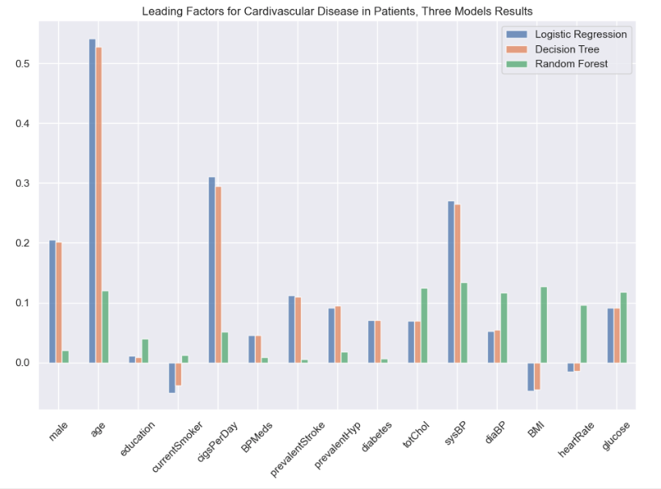
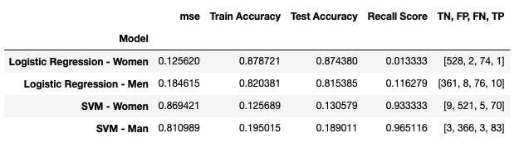
Results for Separately Modeling Men and Women’s datasets. Notice the improvement on SVM recall score.
Leading factors for predicting heart disease within 10 years, as resulted by Logistic Regression, Random Forest, and Decision Tree models. Those are: age, cigarettes per day, systolic blood pressure, being male, prevalent stroke, and blood glucose levels.
Those leading predicting factors are similar, but do not completely overlap in order and in magnitude with the separate analysis for the men and women data.

Slide 6
Conclusion and Suggestions for the Next Steps:
From analyzing the data and according to modeling results ,my first recommendation for care providers is to treat a much broader base of patients. When a model got it right predicting future CVD patients, it predicted a lot of false positives. When the accuracy was better with Logistic Regression model, it missed a lot of patients prone to have CVD. Risk for CVD is quite high as it is - 15%, and this is a condition that can be deadly when first appears, so any patient predicted to be at risk should get treated.
Leading factors for predicting heart disease within 10 years are: age, cigarettes per day, systolic blood pressure, being male, prevalent stroke, and blood glucose levels.
Modeling separately by gender gave better results and better predictive power. Thus my second recommendation for care providers is to treat men and women differently.
My recommendation for future research for the development of medications and diagnosis tools is that it should be conducted in that view of being gender specific, so it is better targeted and have improved predictive power for the population as a whole.

